Slide 1
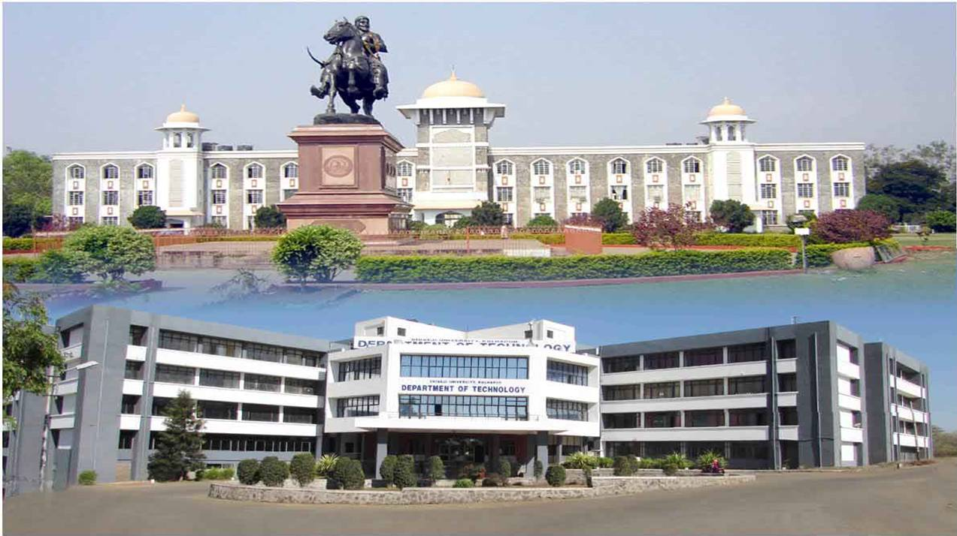
Department of Technology Shivaji University, Kolhapur DTE Code-EN 6028
(Approved by AICTE, New Delhi; DTE, Govt. of Maharashtra) Funded by TEQIP III Program
Feel proud to be a student of prestigious Shivaji University Department

Slide 2
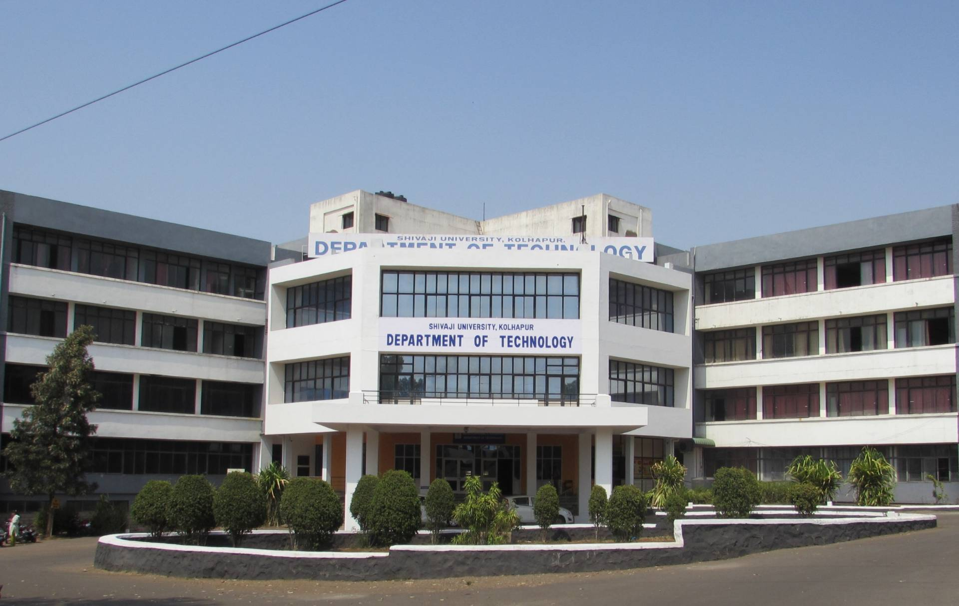
Department of Technology Shivaji University, Kolhapur
DTE Code-EN 6028
(Approved by AICTE, New Delhi; DTE, Govt. of Maharashtra) Funded under TEQIP

Slide 3
Department of Technology
2006 : Shivaji University established Department of Technology with a strong determination to emerge and develop as a premier institute in engineering and technology.
Department of Technology offers B. Tech, M. Tech Programs approved by AICTE, New Delhi and DTE, Mumbai (DTE Code - 6028). We also offer Ph. D. Programs
To be a leader in engineering and technology education, a research centre of global standards to provide valuable resources for industry and society through development of competent technical human resources.
VISION
To undertake collaborative research projects that offer opportunities for consistent interaction with industries.
MISSION
To organize teaching learning programs to facilitate the development of competent and committed professionals for practice, research and academics.
To develop technocrats of national & international stature committed to the task of nation building.

Slide 4
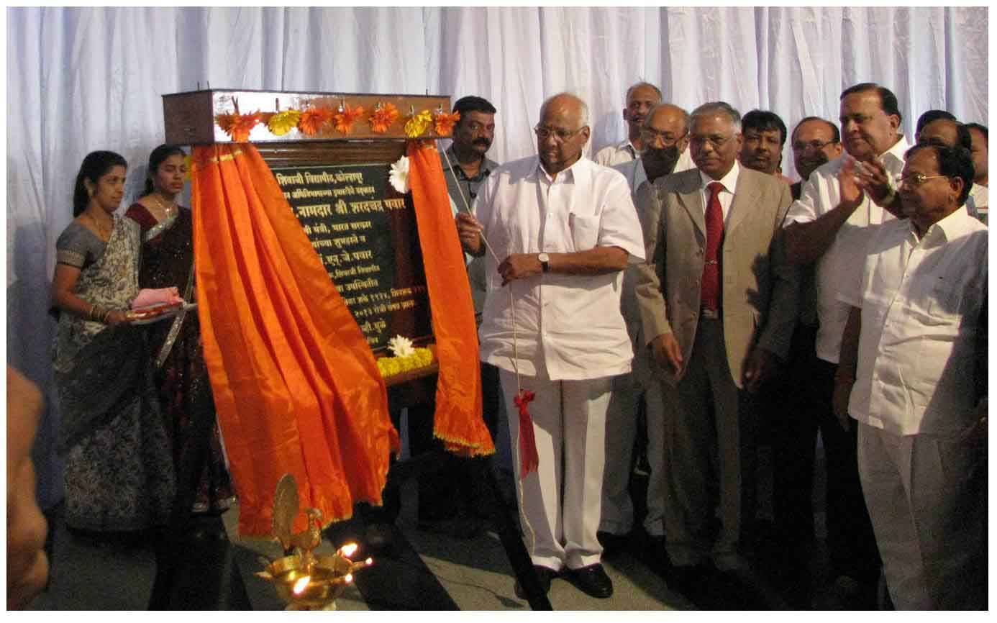
Inauguration of Department of Technology

Slide 5
Programmes offered
B. Tech. Four Year Programmes
Programme Title | Intake
Chemical Engineering | 60
Civil Engineering | 60
Computer Science and Technology | 60
Electronics and Telecommunication Engineering | 60
Food Technology | 60
Mechanical Engineering | 60
M. Tech. Two Year Programmes (* May vary or change)
Programme Title | Intake
Computer Science and Technology | 18*
Electronics Technology* | 18*
Energy Technology | 18*
Environmental Science and Technology | 18
Food Technology | 18
Ph. D. programmes in various Branches of Engineering and Technology

Slide 6
Department Highlights
1. Campus Perspectives :
Academic autonomy.
Funded by world bank and HRD ministry under TEQIP Program worth 17 Crore and worked as the mentor Institute for RGGEC, Kangra, Himachal Pradesh.
Shivaji University is NAAC “A++” grade Accreditation
Curriculum as per the Outcome Based Education System
Audit & Open Elective courses : Besides core courses, curriculum covers special value added courses and courses open to all programme students.
Conducive environment for teaching, learning, research and extension activities.
Provides career opportunities in frontier areas of engineering and technology as well as interdisciplinary areas
Membership of Professional institutes to name the Institution of Engineers (India), Kolkata and the Indian Society for Technical Education, New Delhi

Slide 7
2. Facilities for students :
Well maintained and well furnished hostels for boys and girls having 125 rooms each.
University Sports complex and Health Care center
Well equipped modern laboratories, mechanical workshop, efficient computer networks including Wi-Fi, 24 X 7 CCTV Surveillance
State of the art departmental library, in addition access to the well primed university central library as well as program library.
Advanced Technology Centre, for training, research and development in collaboration with IGTR, Aurangabad.
3. Scholarships for students :
Central and state government scholarships / free ships to eligible students
Special scholarships to meritorious students
Research assistantship to Ph. D. students

Slide 8
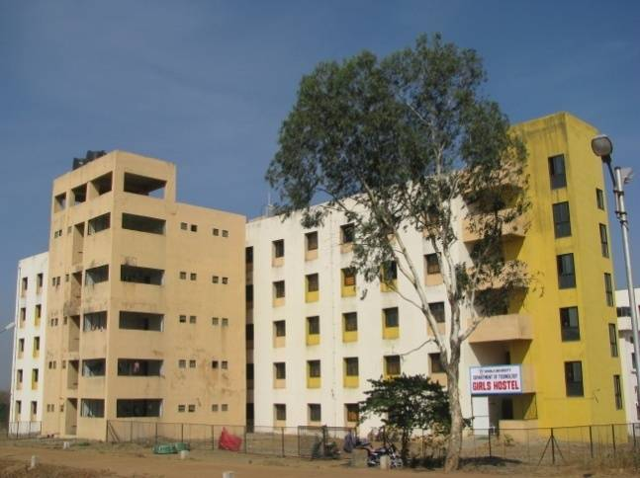
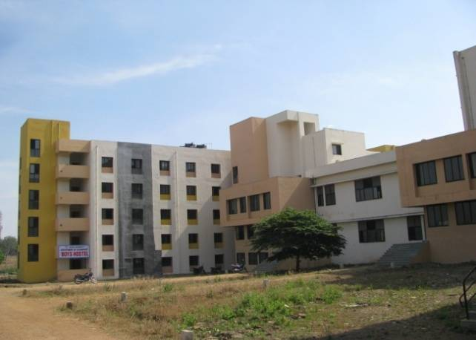
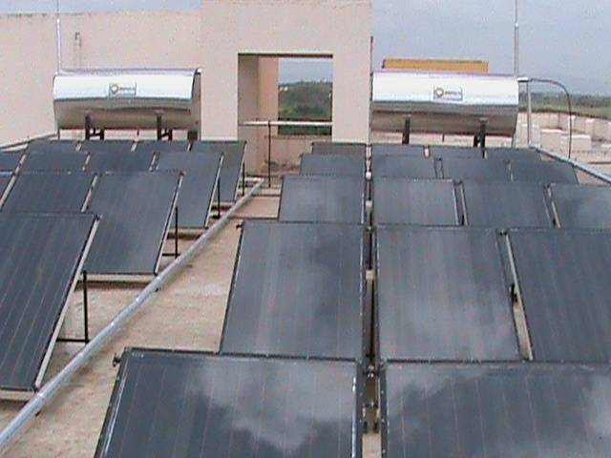

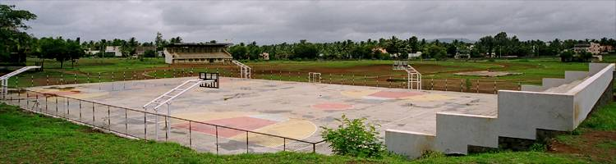
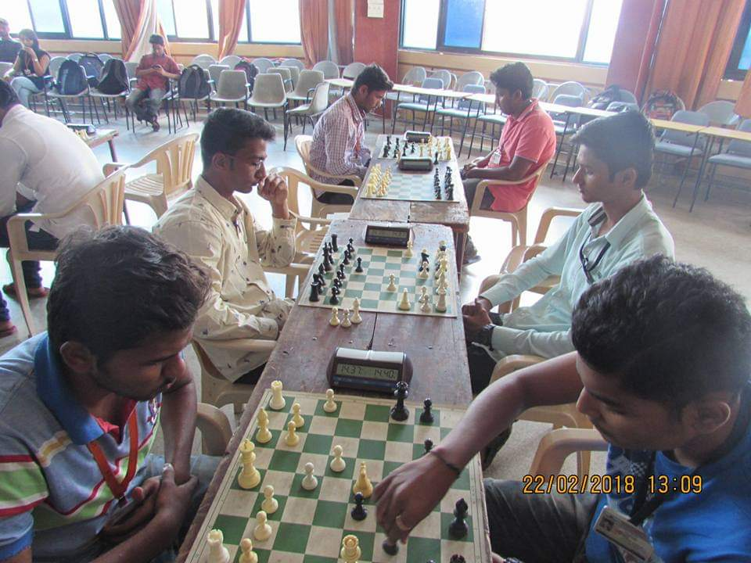
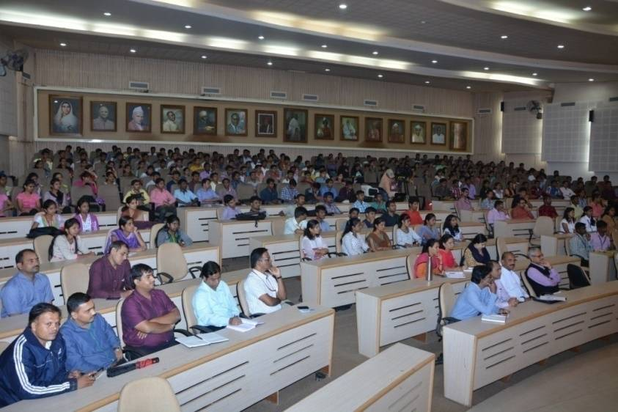
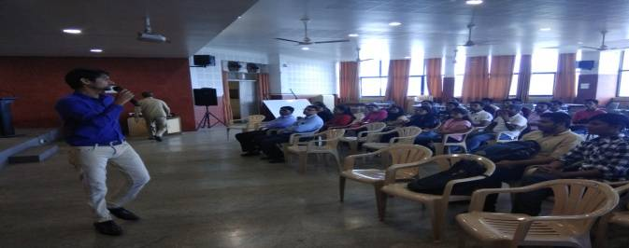
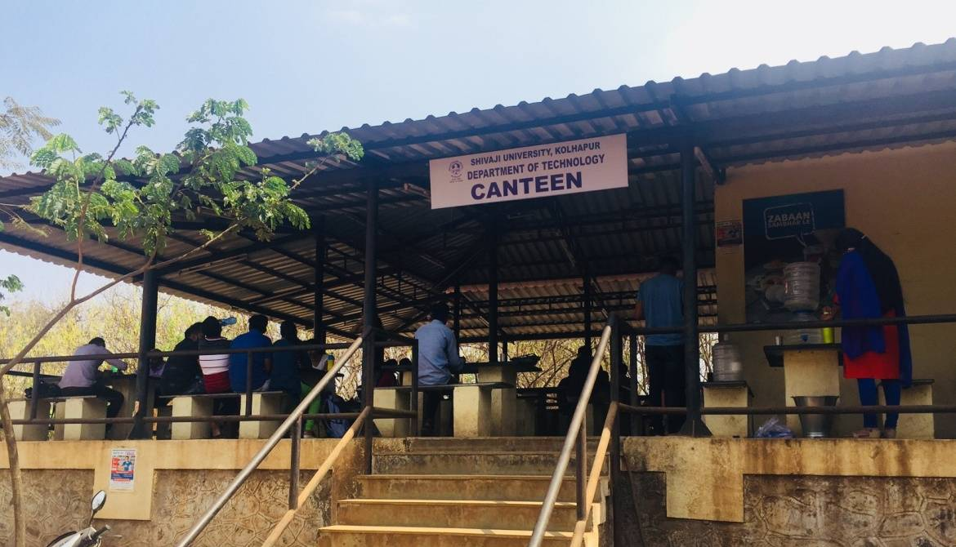
Hostels
Sports Complex
Auditorium, Seminar hall & Canteen

Slide 9
Industry Institute Interaction
Curriculum is developed according to needs and inputs from industrial experts.
Start up and incubation activities with Confederation of Indian Industries (CII), PMKVY, NSQF, DTE-NASSCOM, DTE-MACCIA, MSME IGTR Aurangabad etc.
e-Learning modules developed for enhanced teaching learning experience
Nodal Centre for Spoken tutorial and e-Yantra programme of IIT, Mumbai
Training programs by BOSCH Rexroth, Bangalore, RCF Mumbai and Google Inc.
Advanced Technology Centre (ATC), Developed in collaboration with IGTR, Aurangabad
Remote centre for e-Outreach programme of IIT Mumbai and IIT Kharagpur
Industrial interaction for students and faculty through HR meets and Saturday clubs

Slide 10
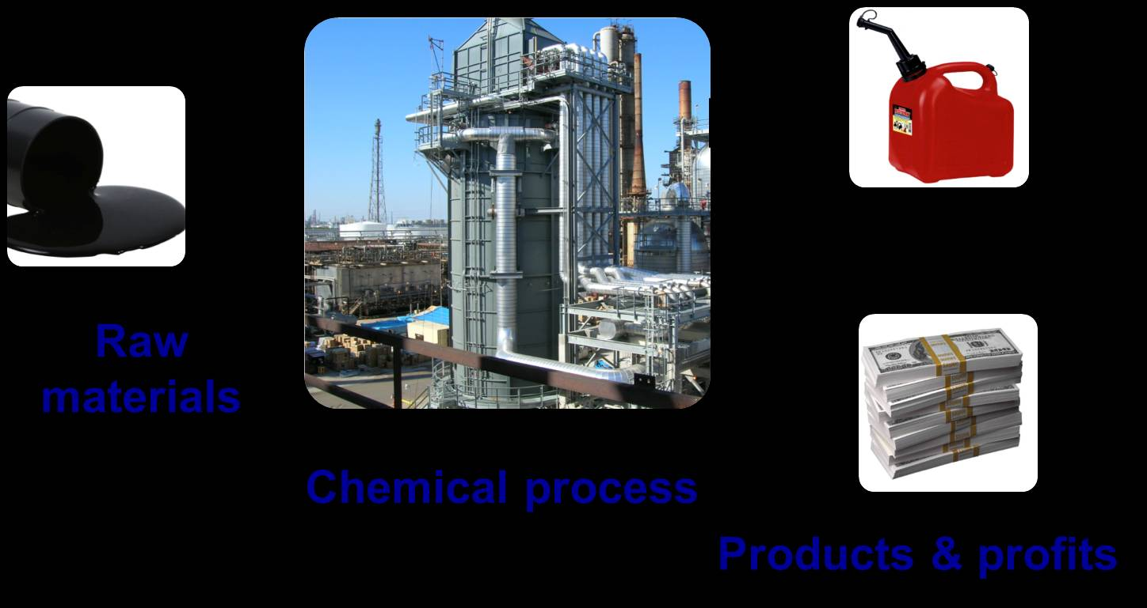
CHEMICAL ENGINEERING
Chemical Industries convert basic raw materials into variety of useful products in an economical as well as eco-friendly way.
Chemical Engineer has good opportunities in:
Chemicals Industries
Petroleum Oil and Gas
Pulp and Paper
Rubber and Plastics
Food and Beverage
Textile Industries
Metals, mineral processing
Agricultural Chemicals Industries
Cosmetics/ Pharmaceutical
Biotechnology/Biomedical

Slide 11
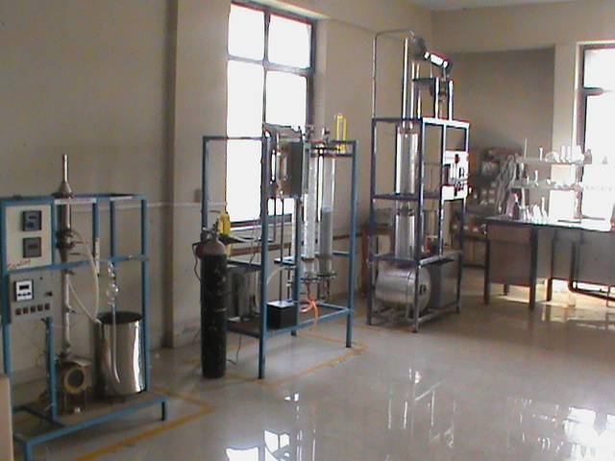
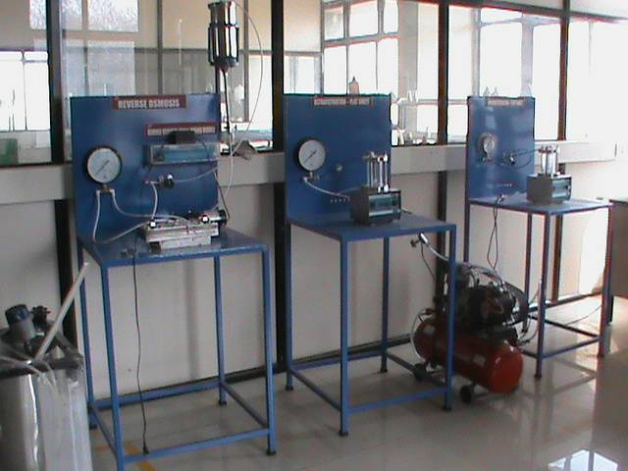
Role of Chemical Engineer :
1. Process Design
2. Process Development
3. Plant Erection & commissioning
4. Manufacturing
5. Technical Sales
6. Researcher
Mass Transfer Laboratory
Research areas
Product and process development
Chemical Process Modeling and Simulation
Industrial Pollution Prevention and control
Advanced Separation Processes
Energy, Water conservation
Natural Product development
Research Project Laboratory

Slide 12
B.Tech. Chemical Engineering) Placements
Placement Drives (This year)
Our Recruiters
UHP Technology, Banglore Ingenero Technologies ( India) Pvt.Ltd. Piramal Ind. Limited , Mahad Lakshmi Organics ltd , Mumbai Viliant Organics Ltd, Mumbai

Slide 13
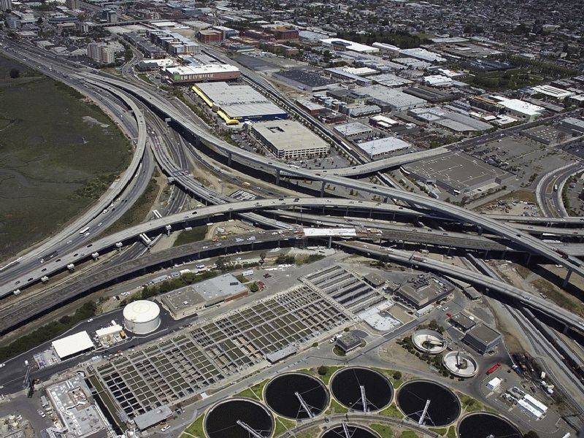
CIVIL ENGINEERING
Scope and Opportunities :
Private Sector
Building design and construction
Real estate
Infrastructure- Highways, Airports, SEZ
Water Resource- Dams and hydraulic structures
Construction planning and management
Government Sector
Public Works Department (PWD)
Irrigation Department (Jalsampada)
Jivan Praddhikaran
Public sector
Railway, Municipal Corporation, MIDC, MSEB, CIDCO, Oil Sector

Slide 14
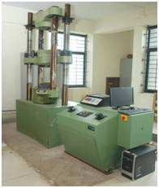
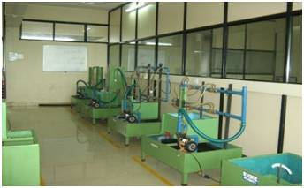
Role of Civil Engineer :
1. Design of Structures
2. Water resources
3. Plant Erection & commissioning
4. Construction Management
5. Project Management
6. Research & Development
Universal Testing Machine
Research areas
Earthquake Engineering
Water Resource Engineering
Transportation Engineering
Water and Waste Water Treatment
Green Building
Fluid Mechanics Laboratory

Slide 15
B.Tech. Civil Engg. Placements
Placement Drives (Duration Feb 2023 to April 2023)
Our Recruiters
SCON Infrastructure Chryso India Pvt.Ltd Aakash Byju’s

Slide 16

B.Tech. Computer Science and Technology Program

Slide 17






RECENT TRENDS IN COMPUTER SCIENCE AND TECHNOLOGY
Big Data Analytics
Artificial Intelligence
Machine Learning
Edge Computing
Cyber Security
Virtual Reality

Slide 18

Program strengths
Experienced And Skilled Research Oriented Faculty Members
Curriculum Designed as Per Industrial Needs and as per The Concept Of Outcome Based Education As Prescribed By NBA
Advanced and well Equipped Laboratories
Innovative Teaching / Learning Methods
More Practical Oriented Approach
100% B.Tech.Admission in AY 2021-2022
100% Placement in 2020-2021 with highest package of 9LPA.

Slide 19
Program strengths
Total 93 opportunities given to batch 2021-22 through Training and placement .
25 students of AY 2021-22 are placed through campus interview
with highest package 5LPA
15 various Training Programs in AY 2021-22
2 IIT Spoken Tutorial Workshops in AY 2021-22
4 Research Projects for CST through RSS in AY 2019-21 of 6Lacs.
2 Expert lecture are conducted for S.Y. to Final Year Students in AY 2021-22

Slide 20
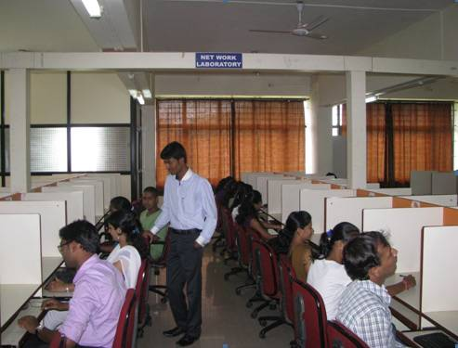
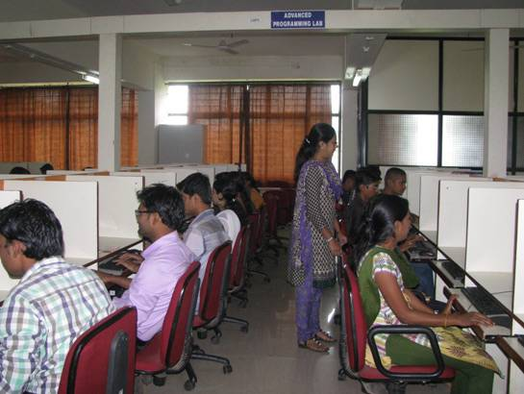


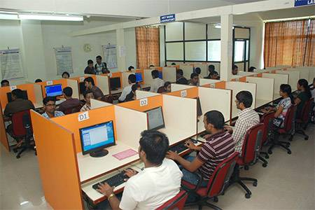
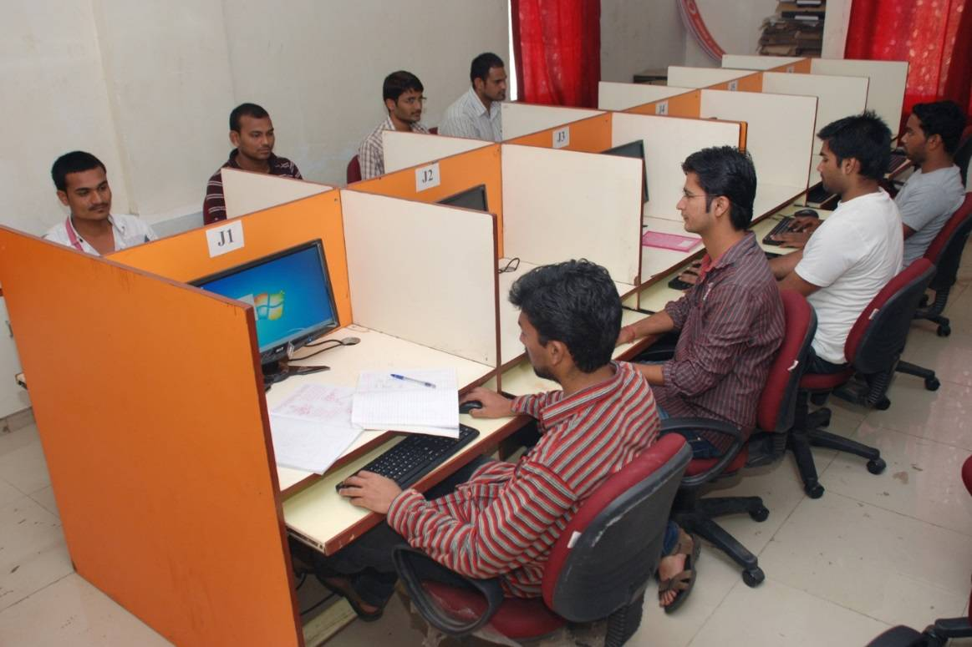



Slide 21
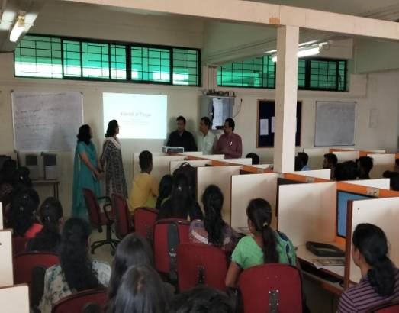
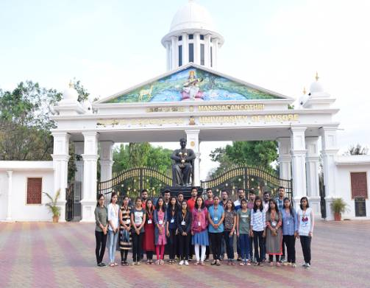
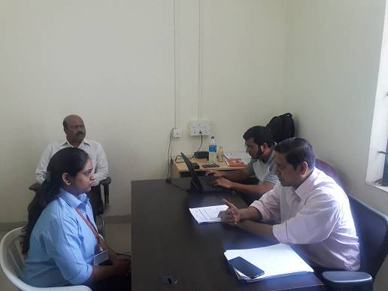
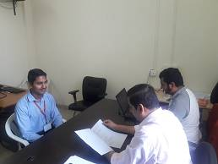
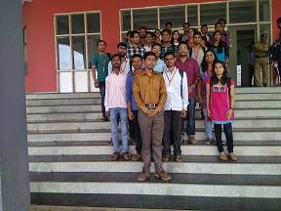

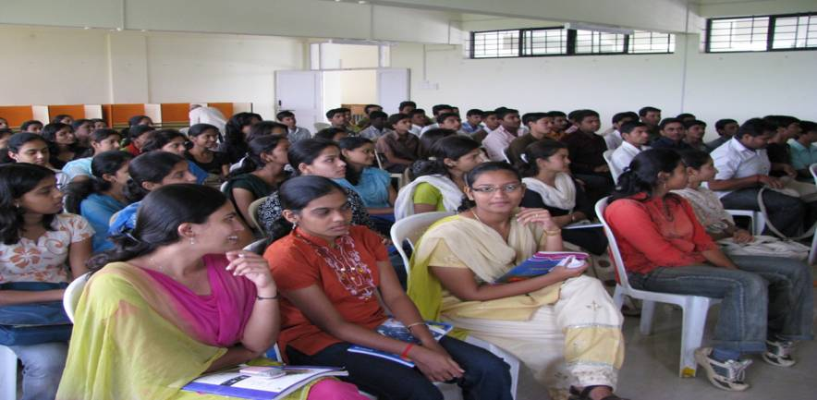
BEYOND CLASS LEARNING
Hands-on Training
Field Visit
Campus placements
NIT Goa, Mysore University
And BigSpire Technology, Bangalore
IoT Training
Iface- Pune,
Walstar and Miracle InfoTech
Workshop on CCNA by IGTR
Logic Development by Walstar Pvt. Ltd.

Slide 22
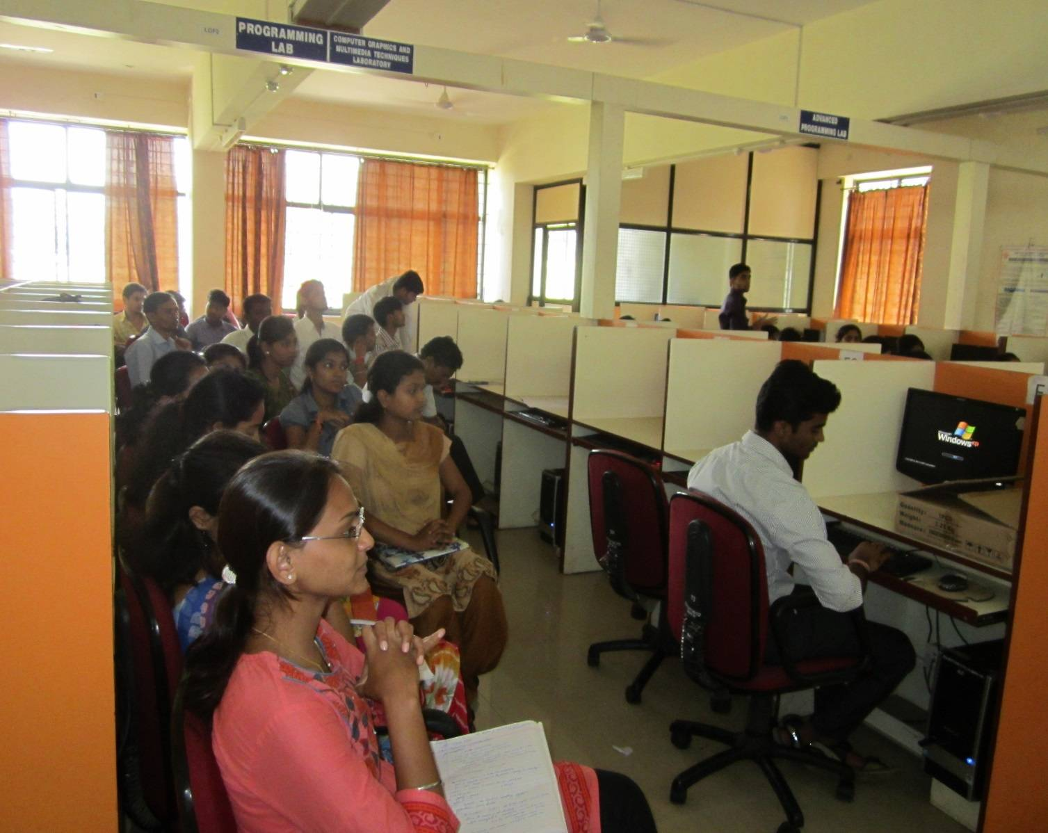
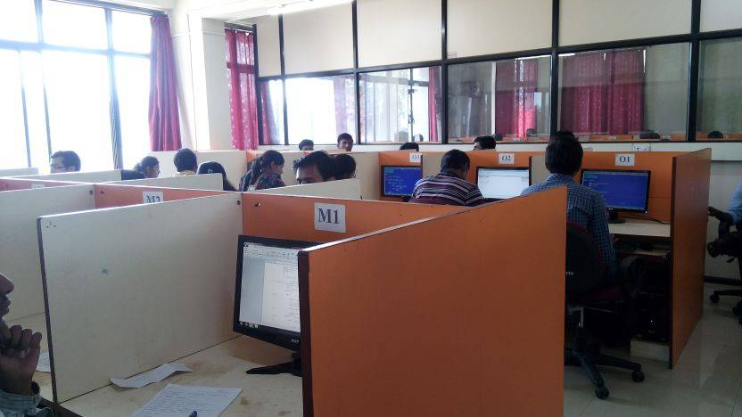
CISCO Certified Network Associate (CCNA) Training program with Indo German Tool Room(IGTR), Aurangabad

Slide 23
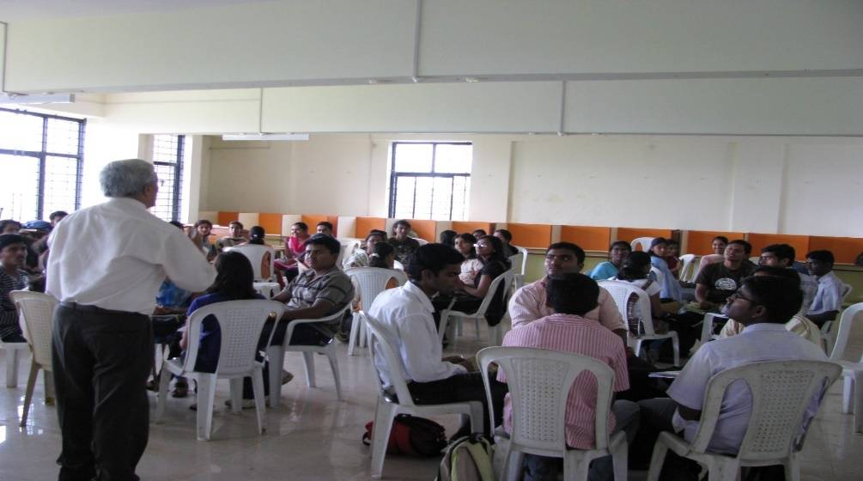
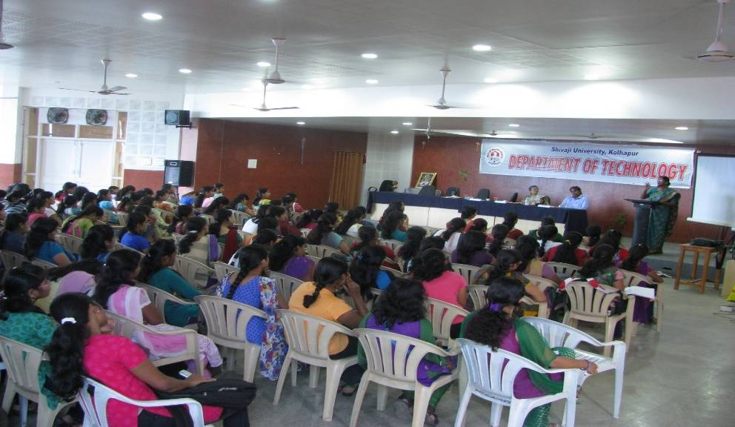
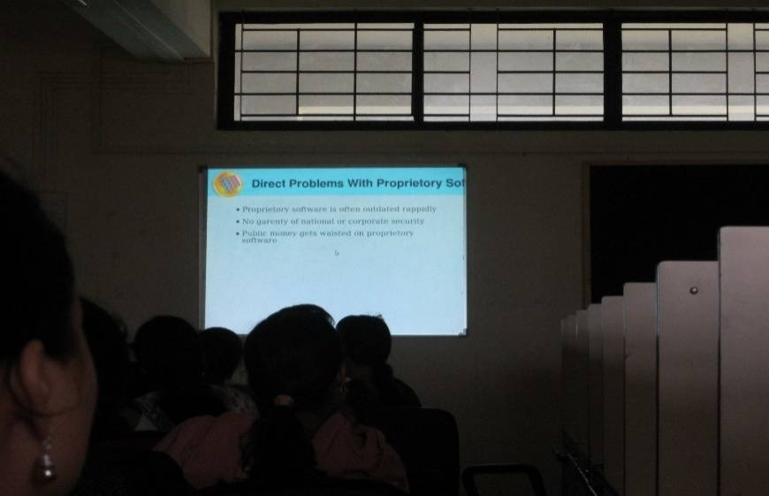
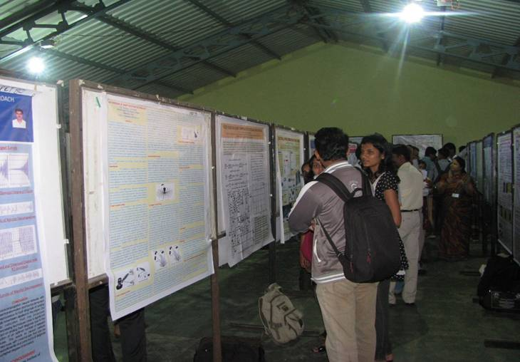

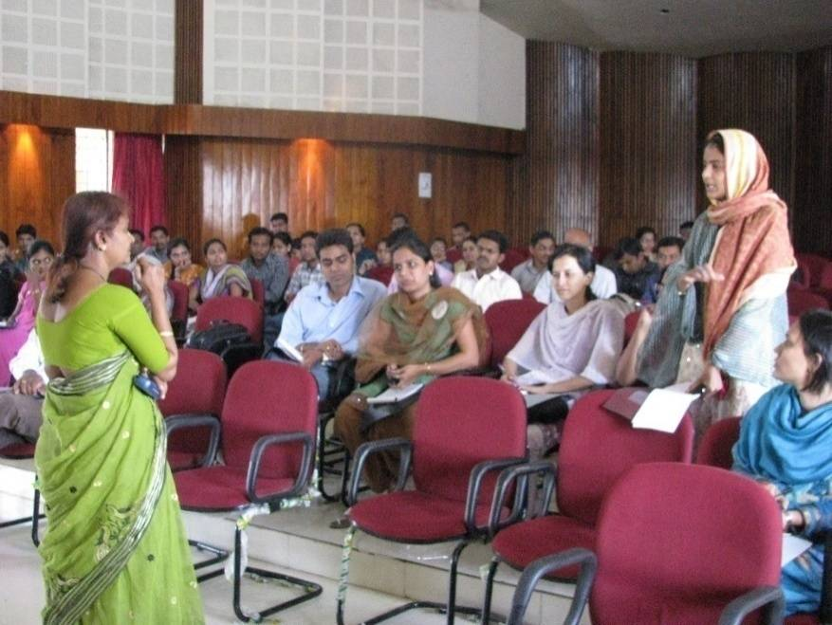
Co-curricular Activities
GATE / GRE/SOFT SKILL Preparation /Tech-Fest(Project Competition, Paper Presentation, Programming Language Test)

Slide 24
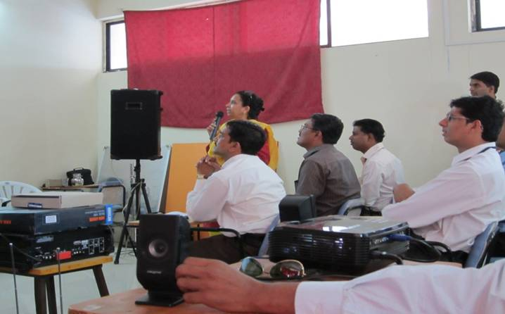
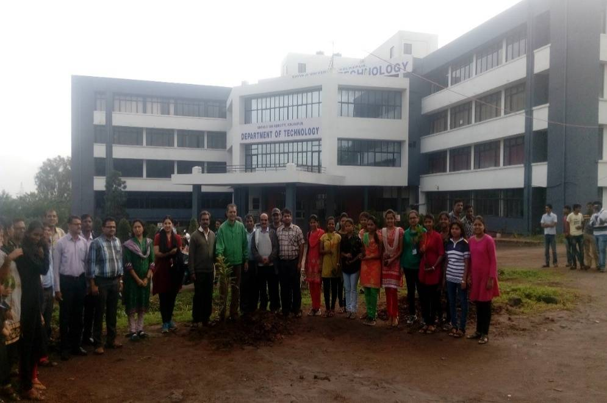
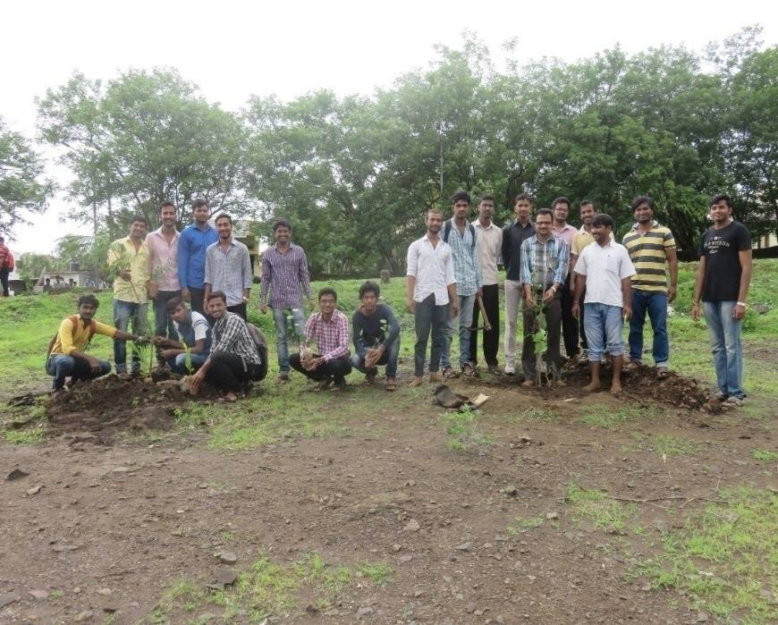
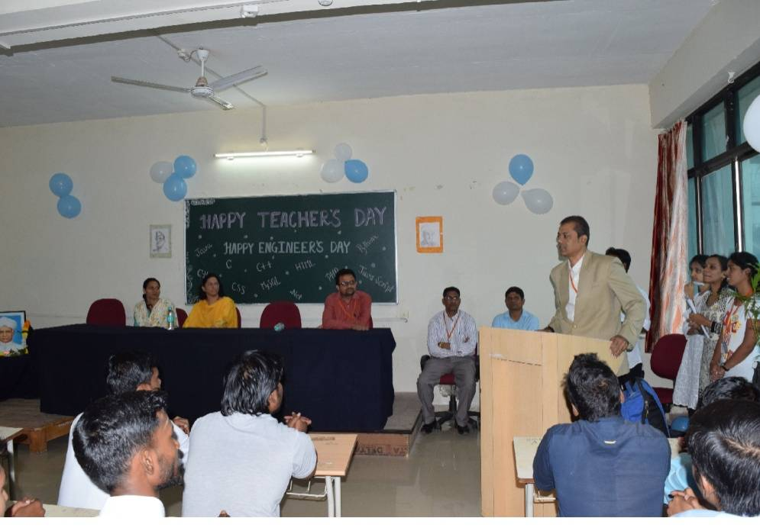
Extra Curricular Activities
Teachers Day
Engineers Day
Tree Plantation
Blood Donation
Sports Day
Alumni Meet

Slide 25

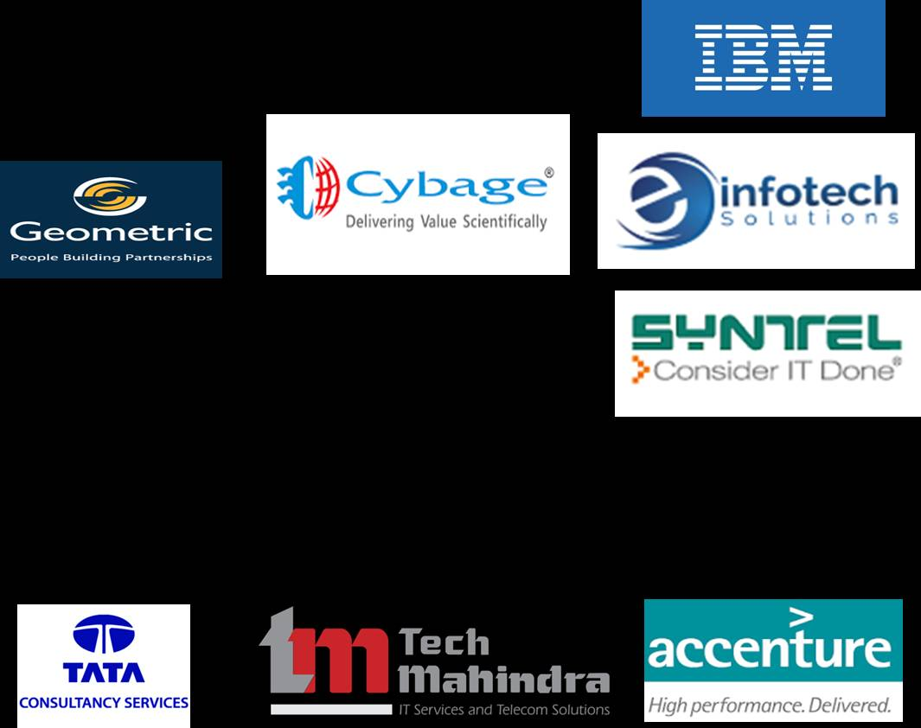



Our Recruiters
Persistent Systems, Pune
TCS, Mumbai
TechMahindra, Pune
Regulus IT
Acti Systems Pvt. Ltd, Pune
Tcognition, Kolhapur
Relish Times, Relish InfoTech, CCR, Pune
L & T Infotech, Mumbai
Wipro Technologies,Pune
Syntel ,Pune

Slide 26
B.Tech. Computer Science & Technology
Placement Drives (Duration Feb 2023 to April 2023)
Our Recruiters
TCS Infosys Wipro Aakash Byju’s Sankay solution Thinqloud Pune Ashok Leyland Hexaware Technologies

Slide 27
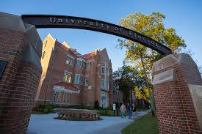
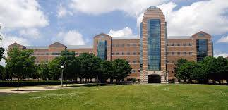


Higher Studies Abroad
Gaurav Mukherjee- New York University
Anthony Figaredo- University of Toronto
Saurabh Chougule-University of Illinois ,Chicago
Amruta Kolekar- North Umbria University, Newcastle upon Tyne
Pratik Chougule- University of Florida, Orlando
Animesh Sagar- Indiana University,USA

Slide 28

ELECTRONICS & TELECOMMUNICATION ENGINEERING
Design, development and testing of the electronic circuits used in various electronic equipment and communication systems .
Electronics and Communication Engineer has tremendous opportunities in:
Private sector
R&D organizations : ISRO, DRDO
Public sector undertakings : BHEL, BEL, ECIL
Government
Defense services
Entrepreneurs

Slide 29
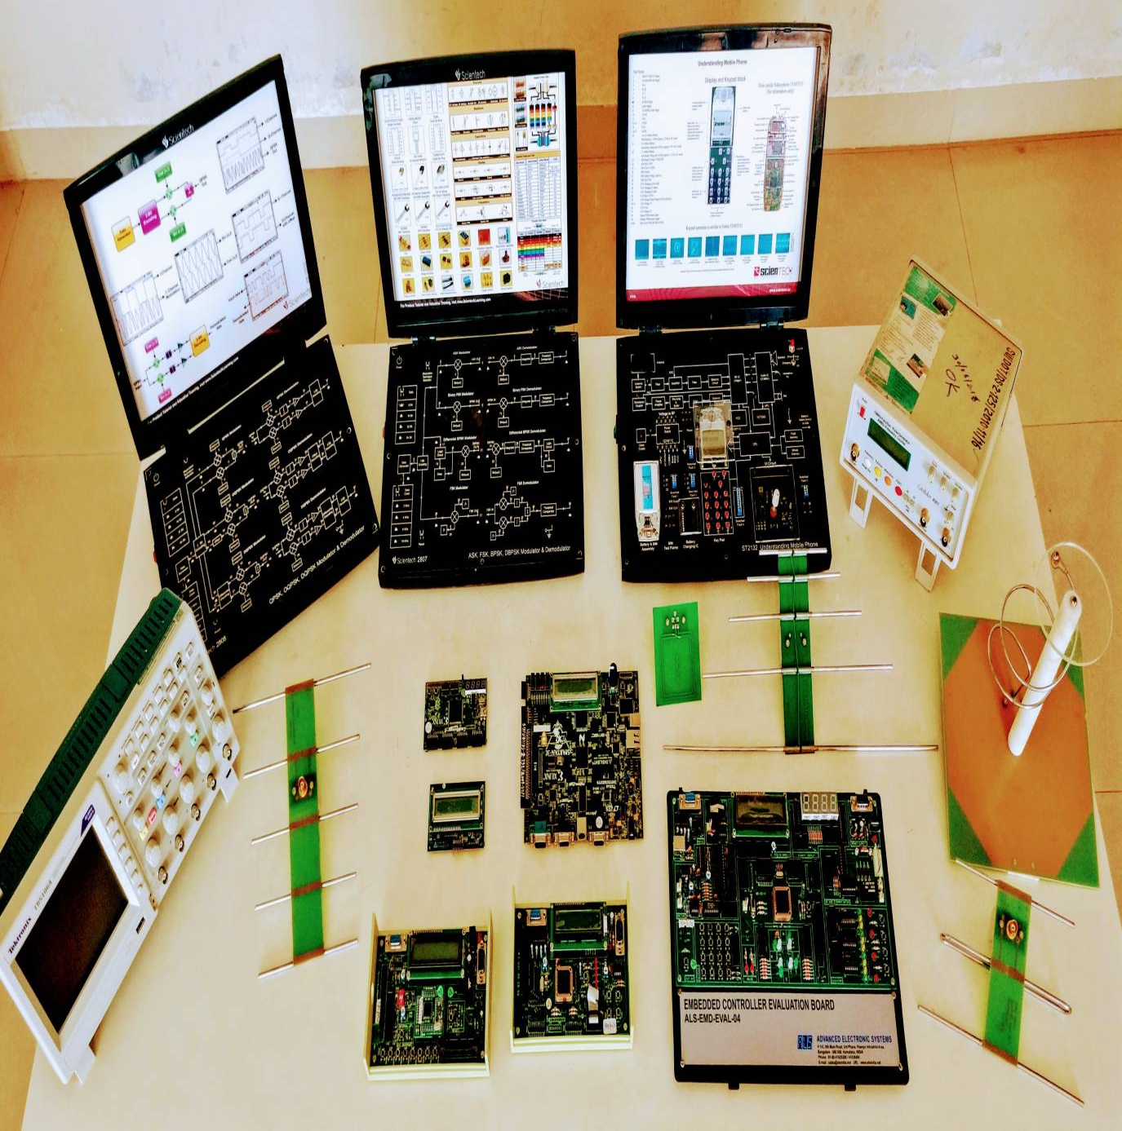
Role of Electronics Engineer :
1. Design Engineer
2. System Developer
3. Component/Equipment Manufacturing
4. Testing and Quality control
5. Technical Sales
6. Research
7. Maintenance Engineer
Research areas
Embedded systems
VLSI Design
Communication Engineering
Antennas
Image processing
Signal processing
Renewable energy
Advanced Electronics Laboratory

Slide 31
B.Tech. Electronics & Telecommunication Engineering
Placement Drives (Duration Feb 2023 to April 2023)
Our Recruiters
TCS Amazon Cyber Success Sankey Solutions Hexaware Technologies Jabil , Pune Quality Kiosk Treel JK India Pvt Ltd Aakash Byju’s Thinqloud Pune Colour Print, Mumbai Exotich Zanini industries

Slide 32

FOOD TECHNOLOGY
Food Technology is the application of Food Science and Engineering to the food preservation, processing, packaging and marketing for the development of safe and nutritious food
Food Technologist has good opportunities in:
Fruits and Vegetable Processing
Confectionary
Dairy
Beverages
Egg, meat, Poultry and fish Processing
Nutraceutical and functional foods
Food quality and food safety
Food packaging
Food Security

Slide 33
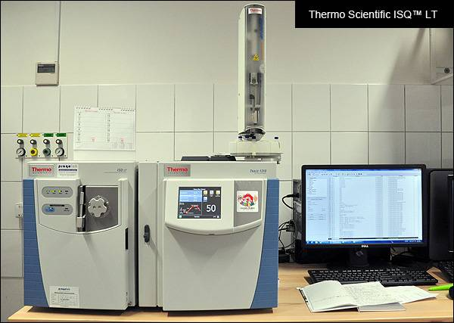
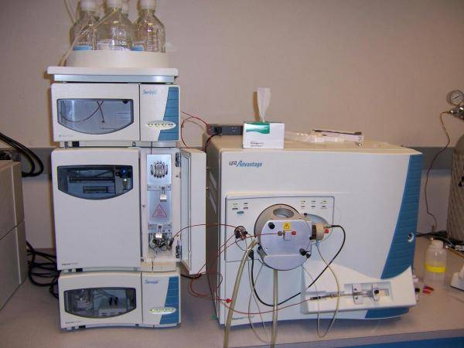
Role of Food Technologist
Production Manager
Research Scientist
Quality Manager
Food Safety Auditor
Food Inspector
Entrepreneur
Food Consultant
Gas chromatography–Mass spectrometry (GC-MS)
Research areas
Nutraceuticals and Functional Foods
Processing and Preservation of Fruits and Vegetables
Utilization of Industrial Waste
Microencapsulation of Food Components
Liquid chromatography–Mass spectrometry (LC-MS)

Slide 34
B.Tech. Food Technology
Placement Drives (Duration Feb 2023 to April 2023)
Our Recruiters
Nestle India Limited ,Bangalore Amul Döehler India Private Limited Piramal Industries Limited , Mumbai

Slide 35
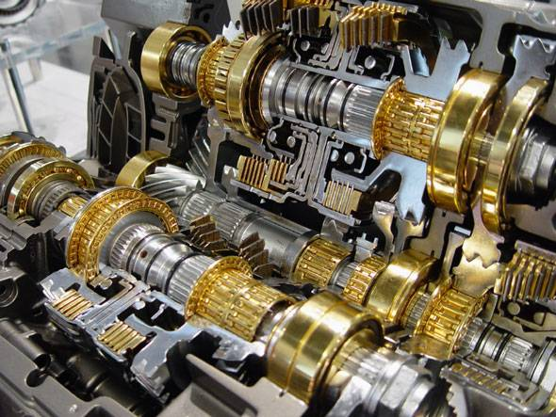
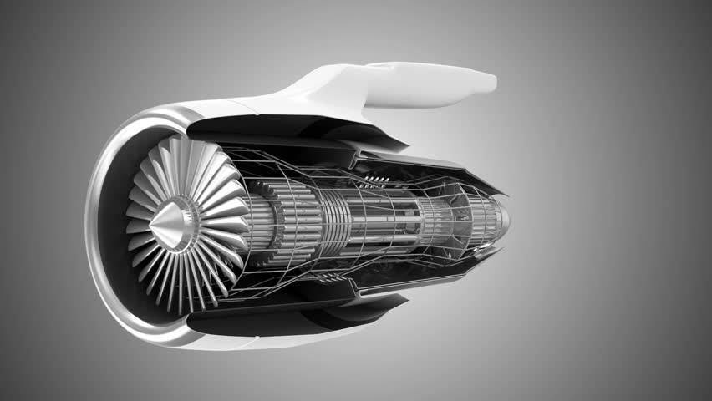

MECHANICAL ENGINEERING
Mechanical Engineering is the application of engineering principles and technological developments for the design and development of useful products and production machinery.
Mechanical Engineer has good opportunities in:
Automobile Industry
Cement Industry
Hydraulics & Pneumatics Industry
Manufacturing Industry
Steel Industry
Power Sector Drilling and Mining Industry
Oil and Gas Industry
Aeronautical Industry
Nanotechnology
Defense Sector
Research & Development

Slide 36
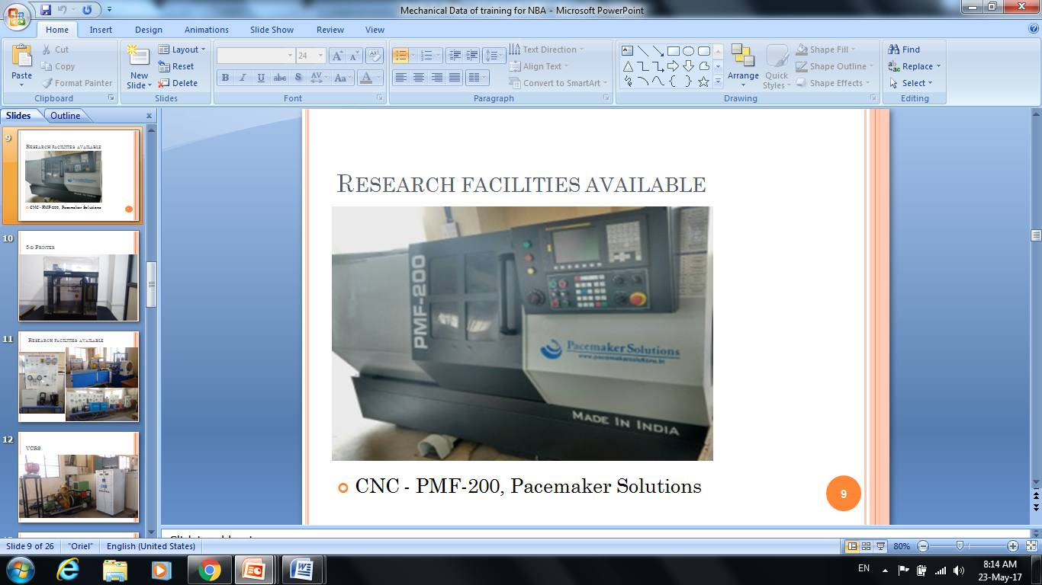
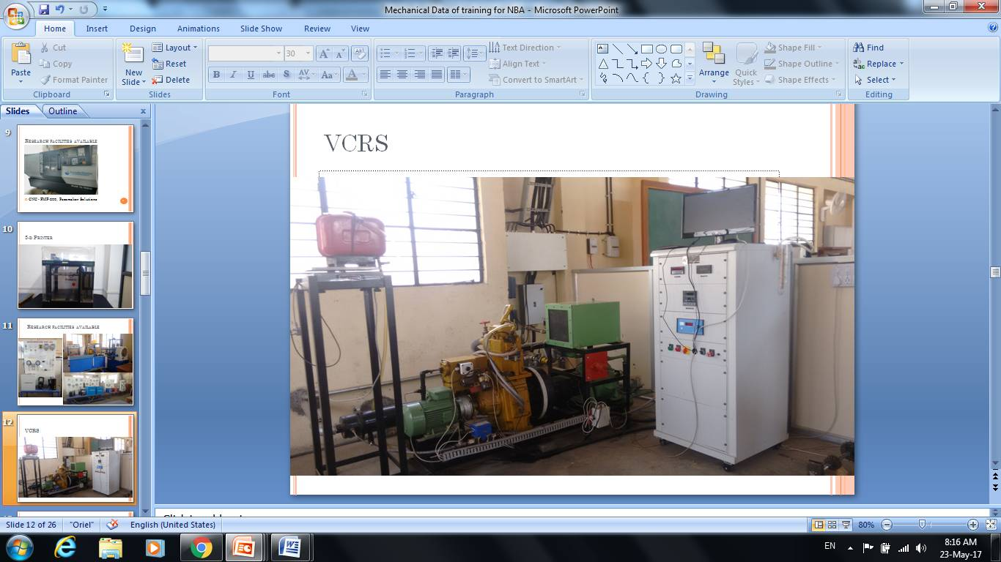
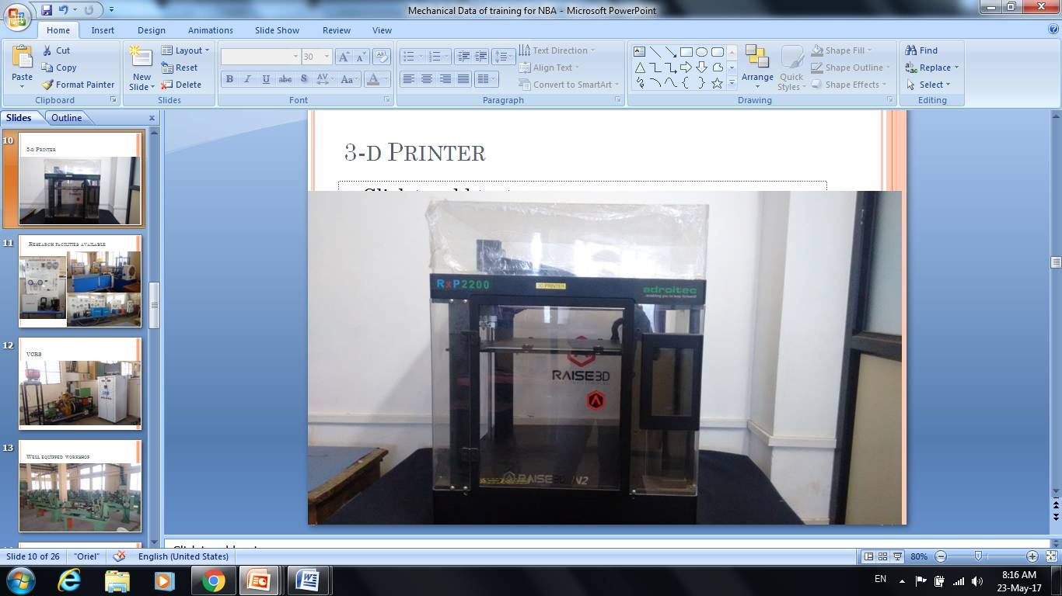
Role of Mechanical Engineer :
Design Engineer
Planning Engineer
Production Engineer
Industrial Engineer
Quality Control Engineer
Entrepreneur
Systems and Management Consultant
CNC Turning Centre
Research areas
Production Engineering and Management– ISO Implementation and consultancy
Ferrous/ Non Ferrous Foundry- Casting Design, Simulation and Defect analysis
Internal Combustion engines
Automobile Engineering
Energy Technology
Computerized IC Engine
3D Printer

Slide 37
B.Tech. Mechanical Engineering
Placement Drives (Duration Feb 2023 to April 2023)
Our Recruiters
TCS Walchandnagar Industries, Pune Menon and Piston Ltd. Menon and Menon Ltd. Treel JK India Pvt Ltd N- Gen Group Colour Print Pvt. Ltd. , Mumbai Exotich Zanini industries RDC Concrete India Pvt. Ltd.

Slide 38
Best Practices
Annual HR Meet
Financial assistance for :
Participation in Seminars/ workshops for technical knowledge enhancement
Industrial study tours
Student internships
Students fees for GATE and other competitive exams
Expert lectures by eminent industrialists
Coaching for – GATE Examination
Training and Placement related activities
Special sessions for aptitude and personality development
Reading and group discussion clubs
Organization of Tech-Fest
Mentor teacher for a batch of 25 students

Slide 39






















Some of OUR RECRUITERS

Slide 40
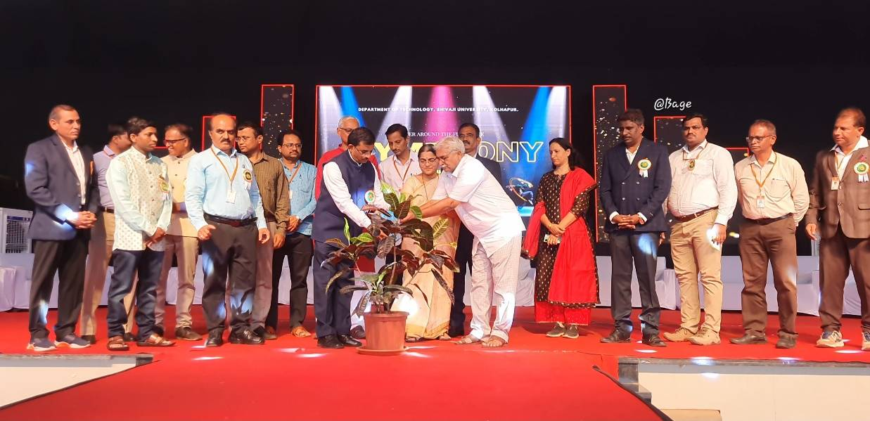



Extra-Curricular Activities
Annual Social Gathering
Shivspandan
Annual Sports
NSS Activities

Slide 41




Extra-Curricular Activities
Disaster Management : NCC
Guidance : Competitive Examinations
Shahu Mill Audit
Shahu Mill Audit

Slide 42




Extra-Curricular Activities
Disaster Management : NCC
Shivspandan

Slide 43


Slide 44





Self Defense Program on the occasion of International Women's Day

Slide 45


Slide 46


Slide 47


Slide 48




TEQIP SUPPORTED ACTIVITIES
Twining Activities with RGGEC, Kangra, Himachal Pradesh
GATE Coaching
Employability Training
Soft Skill Training

Slide 49


Technical Education Quality Improvement Programme
(Project by MHRD, Gov. of India and World Bank)
Activities under TEQIP III
Mentoring to RGGEC, Kangra, Himachal Pradesh
GATE training
Employability Training
Research Funding to Faculty and Project Funding to Students
Infrastructural and Technical Competency improvement through FDP’s, Procurement of equipment's, Laboratory development etc.
Funding to students for GATE & Competitive exams, workshops, conferences, industry visits & training
Total Funding utilized under TEQIP II | 10.5 Crore Rs.
Total Funding sanctioned under TEQIP III | 7 Crore Rs.

Slide 50
Thank you

